Slide 1
527 Data Analytics
Final Project
Compensation Data Analysis of Executives for HP
Group 7
Akshay Patil Anusha Bondili
Aditya Dixit Chandrika Pai
Gururaj Thite

Slide 2
Table Of Contents
Introduction to HP……………………………………………………………………..3
DEF 14A and Summary Compensation Table…………………………………….4
Analysis on the Share Market of the HP…………………………………………...5
Salary Trend Graph……………………………………………………………6
Analysis on Stock Awards…………………………………………………………….7
Analysis on Option Awards……….......................................................................8
Introduction to Corpus………………………………………………………...………9
Term Document Matrix of the Q&A ………………………………………………..10
KEI 2-Words with most number of occurrences( Five Words)…………............12
KEI-3-Words occurring the least number of times ( Five words)……………….13
Words with more than 400 occurrences…………………………………………….14
Word Count in each document for the years 2005-2016……………………...….15
The Word Cloud………………………………………………………………………...16
Key Event Indicators………………………………………………………………… 17
Conclusion……………………………………………………………………………….18

Slide 3
Introduction to HP
HP Inc. refers to Hewlett-Packard is an American technology company, setup on January 1, 1939 and their headquarters set up in Palo Alto, California.
It develops and provides hardware, such as personal computers and printers.
HP Inc had recorded US $57.3 billion in revenue in 2014.
Dion Weisler is the current CEO of the company.

Slide 4
DEF -14A and Summary Compensation Table
DEF 14A is basically a filing with the Securities and Exchange Commission (SEC) that must be filed by or on behalf of a registrant when a shareholder vote is required. It is most commonly used in conjunction with an annual meeting proxy .It includes information about the date, time and place of the meeting of security holders.
Summary Compensation Table contains the detailed report of the various executives of a particular company , the salary data of those executives, the option awards and the stock awards associated for a particular set of years.
  Salary : The yearly income associated with the various top level executives of a company.
  Stock Awards : Shares of stock that have been awarded to an executive with certain conditions that limit the employees rights on the shares as long as he has been employed by the company
  Option Awards: Most of the companies award options awards to retain key employees, executives and directors. These options give holders the right to buy the underlying shares at predetermined prices, known as strike prices, before specified expiration dates.
Notes:
Explained an analogy about the Summary Compensation taking HP as an example with the company trying to retain their employees by offering them Stock and Option awards

Slide 5
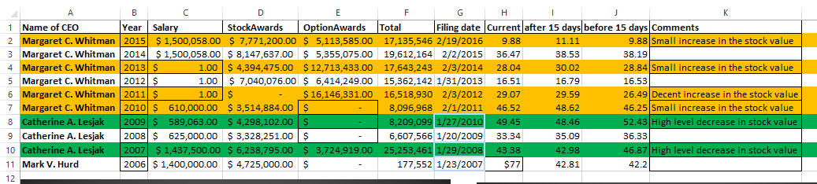
Analysis on the Share Market of the HP ( KEI-1)
The sheet below has the details such as “Salary”, “Stock Awards”, “Option Awards”, “DEF14A” filing date, share market value on the filing date, 15 days before and after the filing date.
When Catherine A. Lesjak was CEO of HP Inc. there was a decrease in share price in the year 2007 and 2009.
When Margaret C. Whitman was CEO of HP Inc. there was a mild increase in share price in the year 2011.
Notes:
According to our analysis ,after 2011 HP has probably applied a strategy of providing Stock Awards or Option Awards as a compensation to lower salaries
And also we can note that the share prices have dipped during this span.

Slide 6
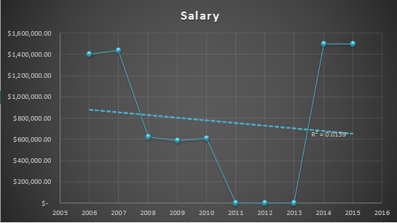
Salary Trend
The figure below shows the salary trend from the year 2005 to 2016
Salary was maximum in the year 2014-2015 and was at the lowest from 2011-2013
The R value of the trend line in the graph is 0.0139 which is not a good fit indicates that the salary distribution has been gradually decreasing.
Notes:
As explained in the slide no 7, the salaries for the 2011-2013 is very low and they have compensated by offering stock/option awards.

Slide 7
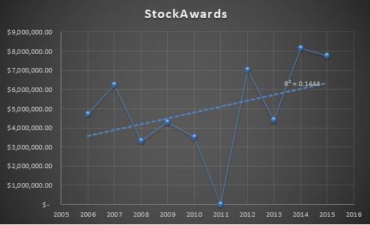
Analysis on Stock Awards
The figure shows the Stock Awards of the company from the year 2005 to 2016
The maximum “Stock Award” was achieved in 2014 and there was no “Stock Award in 2011.
The R value of the trend line in the graph is 0.1444 which indicates that the “Stock Awards” has been gradually increasing.

Slide 8
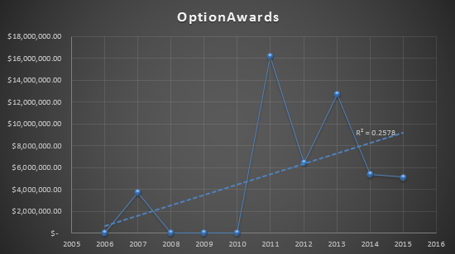
Analysis on Option Awards
The figure shows the Option Awards of the company from the year 2005 to 2016
The maximum “Option Award” was achieved in 2011 and there were no “Option Awards” in 2006,2008,2009 and 2010.
The R value of the trend line in the graph is 0.2578 which indicates that the of “Option Awards” has been gradually increasing.
Notes:
As explained in slide 6

Slide 9
Introduction to Corpus
A Corpus is a collections of texts used for linguistic analyses which is usually stored in an electronic database so that data can be accessed easily. Corpus text consists of thousands or millions of words.
Below are the advantages of corpus analysis:
  A corpus-based analysis can investigate any language pattern i.e., lexical, structural
  It is consistent and reliable.
  It allows the linguists to store and analyze larger database of natural language.
We need to install “tm” package for the analyses of the corpus.
Corpus analysis has been performed for the HP company. DEF 14A (Proxy) Filling has been considered for the HP company from 2005 through 2016.

Slide 10
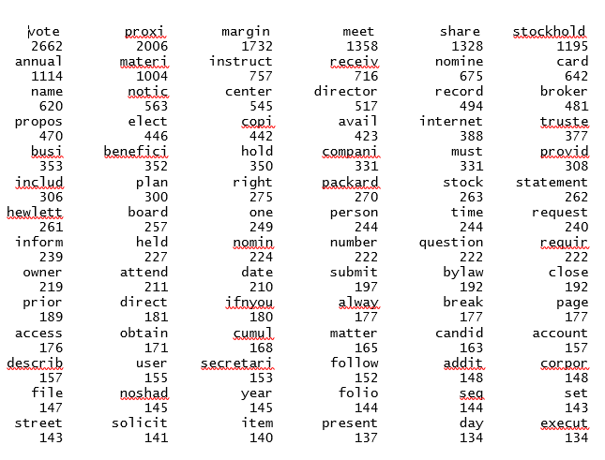
Term Document Matrix of the Q&A
Below is the code for generating the term document matrix:
#finding the frequency
freq <-colSums(as.matrix(dtms))
freq
Screenshot of the term document matrix:
Notes:
Term documents Matrix is a mathematical matrix that describes the frequency of terms that occur in a collection of documents.

Slide 11
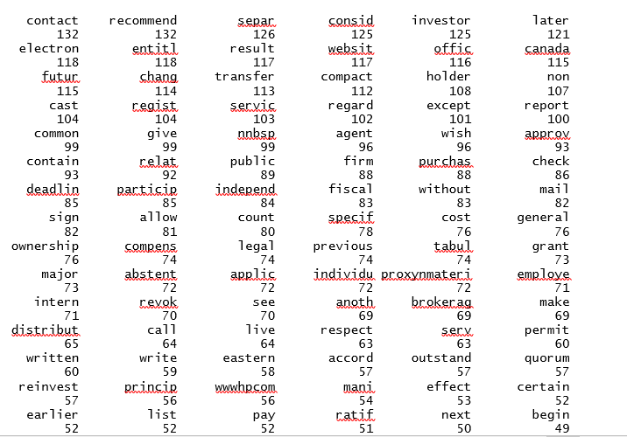
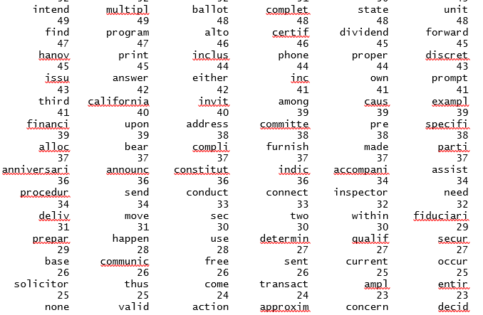
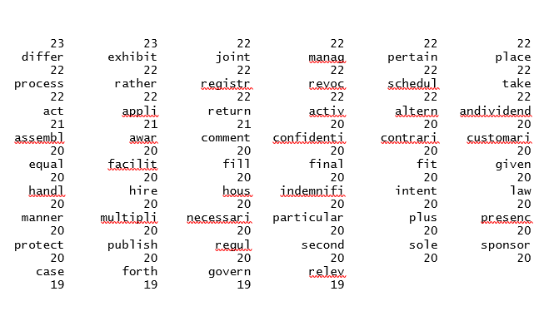
Contd…

Slide 12

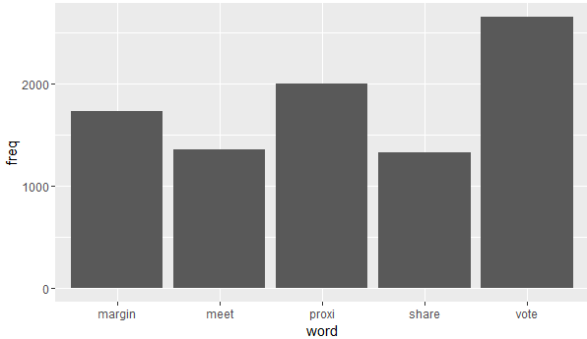
KEI 2 -Words with most number of occurrences( Five Words)
Figure 1
Figure 1: The code to find the words which has occurred more than 500 times.
From figure 2, we can find the top five words that has occurred most number of times . The top five words are “margin”, “meet”, “proxi” , “share” and “vote”.
Figure 2
Notes:
According to our analysis , most of the questions in the Q and A section of the DEF 14A were related to proxy voting and proxy materials ( votes are casted to elect the executives and decide on their compensations accordingly) . Hence vote and proxi are the highest occurring words
Proxy voting usually means , a shareholder can cast his vote through internet ,mail or phone if he/she is unavailable for the meeting

Slide 13
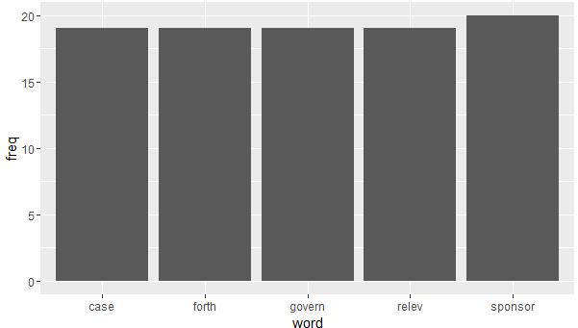
KEI 3-Words occurring the least number of times ( Five words)
Figure 3
Figure 3: The code to find the least five words.
From figure 4, we can find the five words that has occurred least number of times. The least five words are “case”, “forth”, “govern”, “relev” and “sponsor”.
Figure 4

Slide 14
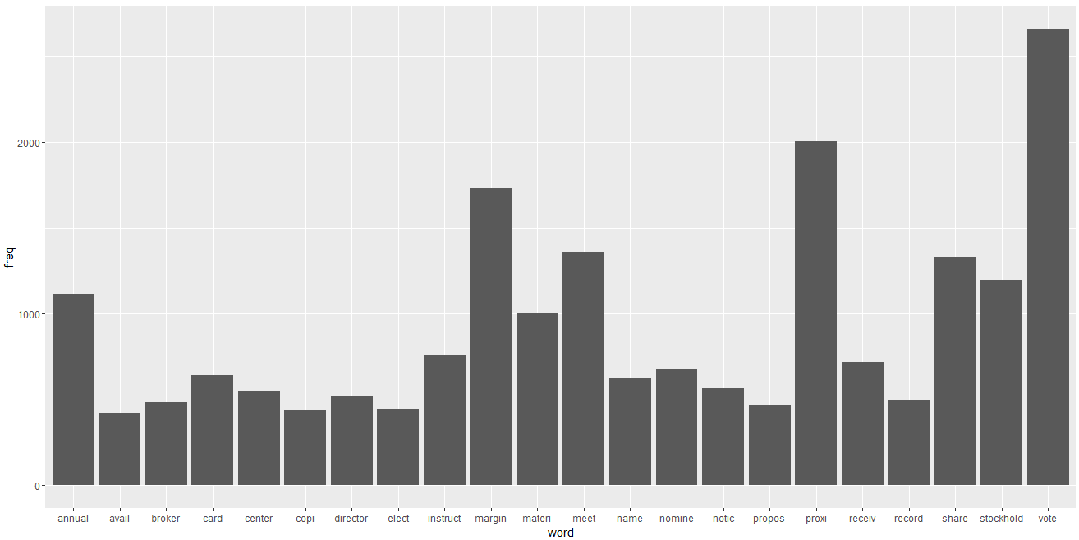
Words with more than 400 occurrences
From figure 5, we can find the words that have occurred more than 400 times.
From the graph, we can find that “vote” and “proxi” have occurred equal to or more than 2000 times when compared with the other words.
Figure 5
Number of occurrence equal to or more than 2000

Slide 15
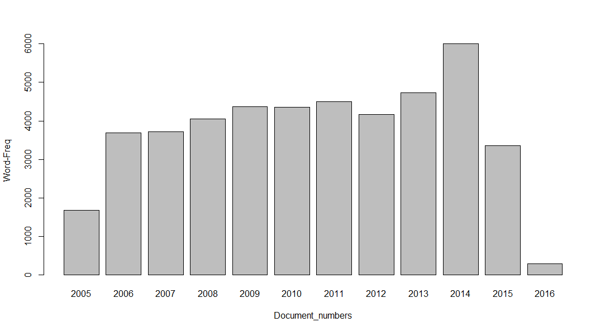
Word Count in each document for the years 2005-2016
Figure 6
Figure 6: The code to find word count in a particular document for the respective years.
From figure 7, we can find the word count in a particular document for the years 2005 through 2016. Year 2014 has highest word count when compared with the other years.
Figure 7
Notes:
Here , from the graph it is evident that for the year 2014 the count of words is maximum. One of the reasons for this could be that in 2013 , most of the questions were probably unanswered and we assume that the share holders might have had certain ambiguity regarding the voting process
. In the year 2016 , the count of words is the least as the questions were usually one liner or two liners.

Slide 16
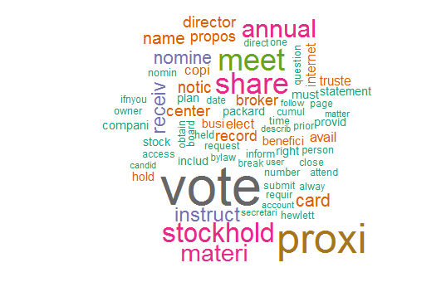
The Word Cloud
Figure 8 is the word cloud after converting all the words to lower case, removing numbers, stop words, punctuations, white spaces, sparse items etc.
Below is the code which generates the following word cloud:
set.seed(123)
wordcloud(names(freq),freq,min.freq =150,scale=c(4,0.5),colors=brewer.pal(8, "Dark2"))
Figure 8
Notes:
This word cloud consists of words which has a minimum of 150 occurrences . The words vote and proxy have occurred most frequently in the Q and A section.

Slide 17
Key Event Indicators
When the Chief Operating Officer was changed in the year 2010 , one can notice a rise in the share value
The words “vote’ and “proxi” have been used most of number of times in the Q and A section for HP
“Case”, “forth”, “govern”, “relev” and “sponsor” are the least occurring words in the Q and A section for HP.
Notes:
The words case forth govern and sponsor are the least occurring as the questions related to sponsorship are very low

Slide 18
Conclusion
DEF-14 A is the best means of informing shareholders of the current compensation details and receive proxy votes from shareholders , hence the word ‘proxi’ and ‘Vote’ have the most number of occurrences in the Q & A Section.
According to our analysis HP probably employs a strategy of offering stock awards instead of salaries to its executives when the share prices are running low.

